Slide 1
Emotion Detection
Using twitter data set and spacy algorithm

Slide 2

AGENDA
Abstract
Introduction
Existing System
Limitations of Existing System
Proposed System
Wordnet and Emosenticnet
Literature Survey
Conclusion

Slide 3
ABSTRACT
People show emotions for everyday communication. Emotions are identified by facial expressions, behavior, writing, speaking, gestures and physical actions. Emotion plays a vital role in the interaction between two people.
The detection of emotions through text is a challenge for researchers. Emotion detection from the text can be useful for real-world application. Automatic emotion detection in the original text aims to recognize emotions in any digital medium by using natural language processing techniques and different approaches.
Enabling machines with the ability to recognize emotions in a particular kind of text such as twitter’s tweet has important applications in sentiment analysis and affective computing. We have worked on the newly published gold dataset (AIT-2018) and propose a model consisting of lexicalbased using WordNet-Affect and EmoSenticNet with supervised classifiers for detecting emotions in a tweet text.

Slide 4
INTRODUCTION
Language is known to be powerful instrument for communicating and conveying information and for expressing emotions. In the world of today’s social network, users share their opinion and emotions in their way through different medium like Twitter, Facebook, Instagram, and many more.
This gave researchers an excellent opportunity to analyse emotions of social networking users’ activities. As public have different thoughts, it becomes a challenge to analyse correct emotion from the data.
Here, we will study and analyse previous works done in this area, identify research scope, methods used and finally propose a system that will help us detect an emotion which is expressed in tweets.

Slide 5
EXISTING SYSTEM
The authors first fetched the tweets from twitter to create a dataset. Then they obtain target based extended features model. They trained four different supervised classifiers, Naïve Bayes (NB), Support Vector Machine (SVM), Maximum Entropy (MaxEn), Artificial Neural Networks (ANN).
The authors focus on identifying seven different classes of emotions - anger, disgust, fear, guilt, joy, sadness, shame. To extract features, preprocessed data is tokenized and then stemmed using porter stemming algorithm. Authors used Unigram, Bigram and Trigram feature.
The author showed a hybrid model for emotion detection. In this model, it contains lexicon keyword spotting, CRF based emotion detection using NB, MaxEn, and SVM.

Slide 6

LIMITATIONS OF EXISTING SYSTEM
For detecting emotions from tweets, we have used the lexical affinity method combined with learning-based methods to automatically classify multi-class emotions from our dataset.
We have used Word Net-Affect and Emo Sentic Net emotion lexicon to extract the emotion containing words as features from the tweet separately.
Word Net-Affect returns the emotion representing words from the tweets which is then considered as features but in most cases, it is unable to take the words which may not be an emotion word but do represent an emotion.
On the other hand EmoSenticNet is an extension of Word Net-Affect which also apply the Sentic Net rules. It then also finds the features which are not contained in Word Net-Affect.

Slide 7
PROPOSED SYSTEM
Raw twitter data has to be pre-processed to create a dataset which will be easy for different classifiers to generate good results.
We do the pre-processing on tweets which are as follows:
Removing tweets that are not in English.
Converting the tweet to lower case.
Removing URL from the tweet.
Removal of mentions, retweet mentions, and unnecessary numbers.
Separation of hashtags as they can play a vital role in emotion analysis.
Changing short form words to their full form. E.g. btw stands for by the way.
Changing the emoticons with their meaning. E.g. (“:D”) stands for laugh/joy with respect to table I.
Word tokenizing
Striping punctuations [’"?!,.():;] from the tokenized words.
Stop words removal from the tokenized words.
Stemming and lemmatizing the tokenized words.
In the end, making parts of speech tag for those tokenized words

Slide 8
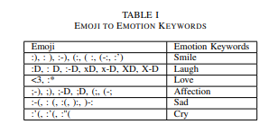
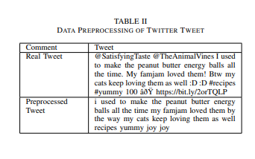
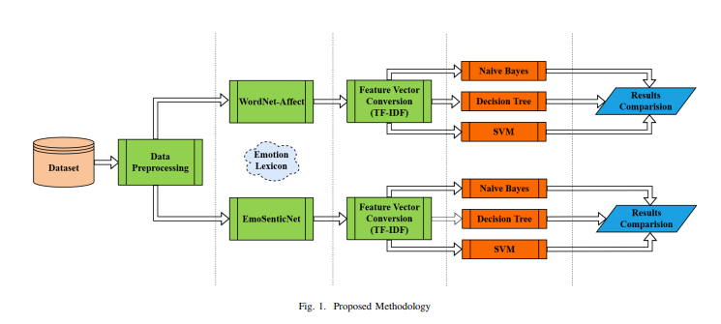

Slide 9
WORDNET AND EMOSENTICNET
As the dataset is a labeled one, each tweet has its own emotion with it. But as we are focusing on emotion words in tweets, we filtered out the emotion words from each tweet and stored them into a Pandas Data Frame, which was later used in training and testing the model. Here it should be noticed that we are assuming each tweet has only one emotion words.
After the data is preprocessed we have used Word Net Affect which is a subset of Word Net with only emotion words. We have mapped those words with our tweet’s words and retrieve the emotion words only (words which represent the emotion of any kind). Then we took those emotions words as features.
Emo Sentic Net is another lexical resource that assigns six Word Net Affect emotion labels to Sentic Net concept. It can also be thought of as an expansion of Word Net Affect emotion labels to a larger vocabulary

Slide 10
LITERATURE SURVEY
A survey on emotion detection techniques using text in blogposts.
Emotion Detection in text documents is essentially a content - based classification problem involving concepts from the domains of Natural Language Processing as well as Machine Learning
Impact of social media on intercultural adaption.
Intercultural adaptation involves the process of promoting understanding through interaction to increase the level of fitness so that the demands of a new cultural environment can be met. Research shows that people tend to use social media to become more integrated into the host culture during their adaptation and to maintain connections to their home countries.
Computational approaches for emotion detection in text
Emotions are part and parcel of human life and among other things, highly influence decision making. Computers have been used for decision making for quite some time now but have traditionally relied on factual information . It shows how these models have been used by discussing computational approaches to emotion detection.

Slide 11
LITERATURE SURVEY
Use of word clustering to improve emotion recognition from short text
However, in emotion recognition, the texts involved are usually very short, leaving a very large, sparse feature space, which decreases the performance of emotion classification . representing short texts with word cluster features, offering a novel word clustering algorithm, and using a new feature weighting scheme.
Multiclass emotion extraction from sentences
The multinomial naïve bayes (mnb) classifier provides good results when the unigram feature set size is 450 which provides an average accuracy of 76.96% across all emotion classes. The extraction of different classes of emotion from sentences using supervised machine learning technique.
A hybrid model for automatic emotion recognition in suicide notes
Focused on the development of automatic systems that identify, at the sentence level, affective text of 15 specific emotions from suicide notes. We propose a hybrid model that incorporates a number of natural language processing techniques, including lexicon-based keyword spotting, crf-based emotion cue identification, and machine learning-based emotion classification.

Slide 12
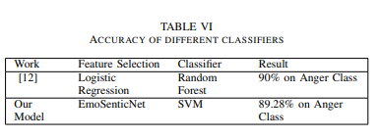
CONCLUSION
Emotion detection is one of the toughest problems to solve.
We can say after using Emo Sentic Net lexicon, the model performs better than using only Word Net-Affect. It can be also said that our model has performed well but still better results are achievable. As for accuracy, the Emo Sentic Net outperforms Word Net-Affect by a great margin.
Our limitations are that we have used a small sample as our dataset and there are still language ambiguity problems as we have not been able to address texts which represent multiple emotion at the same time. In the future, we will introduce Deep Learning techniques to identify emotion detection on this dataset.

Slide 13
THANK YOU
PRESENTED BY:
s. Srinivasa reddy 21Q91A66B1 s. Snehita dhatri 21Q91A66A9
n. Vinay 21q91a6696 k. Venkat reddy 21q91a6685 under the guidance of: mrs.mineesha
(Assistant professor)

